Slide 1
735 Riverside Dr. / Jackson, MS / 601.718.4642 / mshomecorp.com

Slide 2
Monitoring and Grant Closeout,
What to Expect?

Slide 3
Objectives
Attendees of this session will receive valuable information to enhance their management of federal grant programs and improve program outcomes. This session will cover the Monitoring/Grant Closeout process and what to expect!
Notes:
Tamara

Slide 4
Outline
Monitoring Steps
Universal Regulation Requirements
ESG/ESG-CV Monitoring
Closeout
Notes:
Tamara

Slide 5
Grantee Monitoring Overview
Mississippi Home Corporation the State agency for the distribution of ESG, HOPWA and HOME funds is required to monitor each program, function, and activity funded by its ESG and HOPWA and award
Monitoring is not limited to a one-time event but is rather an ongoing process that assesses the quality of ESG & ESG-CV funded program performance over the life of the Standard Agreement and involves continuous communication and evaluation. This is done through program monitoring and RFC reviews.
The goal of this process is to assist ESG and HOPWA funded programs with improving performance, increasing capacity, and avoiding or remedying instances of non-compliance
Notes:
Faye

Slide 6
Grantee Monitoring Overview
MHC’s grantees are required to participate in monitoring and reporting on the performance of their funded programs, including those implemented by:
Direct service providers
Contractors
Notes:
Faye

Slide 7
Grantee Monitoring Overview
MHC’s grantees are expected to make ALL program records available to MHC for, and to participate in, regular monitoring events.
Notes:
Faye

Slide 8
HUD/HUD OIG
Monitoring, Audit & Oversight of MHC
MHC
Monitoring & Oversight of Grantees
Internal Monitoring Audit, & Oversight
Subrecipients
Local Program Implementation
Reporting
Notes:
Faye

Slide 9
Process & Outcomes
Risk Assessment
Monitoring Notification
Monitoring Report
Monitoring Preparation
Monitoring Response from Subrecipient

Slide 10
Process & Outcomes
Potential Monitoring Outcomes
Clear: No concerns or findings identified (none). No validation or additional information on program policy and practices required.
Concern: A concerning condition identified, that if not corrected, may result in a violation of the program regulations and program requirements.
Finding: A violation of the program regulations and/or program requirements.

Slide 11
Risk Assessment
Monitoring Notification
Monitoring Report
Monitoring Preparation
Monitoring Response from Subrecipient
Consistent with HUD requirements detailed in the CPD Monitoring Handbook and CPD Notice 14-04, MHC conducts a risk assessment on entities implementing federal funded activities to identify the risk of fraud, waste, abuse, and non-compliance
Notes:
Faye

Slide 12
Risk Assessment
Monitoring Notification
Monitoring Report
Monitoring Preparation
Monitoring Response from Subrecipient
Triggers on the Risk Assessment includes:
Turnover of key staff
Frequent and multiple concerns on RFC/documentation
Budgets more than $
Delayed on documentation
Delayed in RFC
Notes:
Faye

Slide 13
Risk Assessment
Monitoring Notification
Monitoring Report
Monitoring Preparation
Monitoring Response from Subrecipient
MHC will complete a Risk Assessment Worksheet for each grantee.
The risk assessment is measured on a 100-point scale whereby each grantee is assigned points for various factors which are summed up to a total score that corresponds with the following risk categories: • High risk (51-100) • Medium risk (30-50 points) • Low risk (0-29 points)
Notes:
Faye

Slide 14
Risk Assessment
Monitoring Notification
Monitoring Report
Monitoring Preparation
Monitoring Response from Subrecipient
Notes:
Faye

Slide 15
Risk Assessment
Monitoring Notification
Monitoring Report
Monitoring Preparation
Monitoring Response from Subrecipient
Determine the type of monitoring (on-site or desk) to be performed, the area(s) that will be reviewed, and the monitoring checklists to be used.
Conduct a spot review of RFCs and in data systems to identify areas of concerns.
Identify any records that will be reviewed during the monitoring and determine which document will be requested.
Notes:
Faye

Slide 16
Risk Assessment
Monitoring Notification
Monitoring Report
Monitoring Preparation
Monitoring Response from Subrecipient
Grantees are encouraged to review the following throughout the implementation of their program to avoid a monitoring that results in a concern or a finding.
Program Agreement and additional Grant Modifications
Monthly and annual performance reports
Are you meeting set goals
Request for Cash forms. Are all reimbursements eligible, reasonable, and appropriate? Do you have needed supporting documents that meets state and federal requirements?
Written Standards
Does everything lineup
Do you have a clear separation in your grants
Notes:
Faye

Slide 17
Risk Assessment
Monitoring Notification
Monitoring Report
Monitoring Preparation
Monitoring Response from Subrecipient
Once the date of the monitoring is determined, an Intent to Monitor Letter and email will be sent to the grantee before the monitoring event
The letter should include the following:
Date(s) of the monitoring event and a statement indicating whether the review will occur remotely or on-site
Activity(ies) and area(s) to be reviewed
A request of deidentified applicant list from HMIS/other
A list of requested documents. Additional documents may be requested during and after the monitoring.
Notes:
Faye

Slide 18
Risk Assessment
Monitoring Notification
Monitoring Report
Monitoring Preparation
Monitoring Response from Subrecipient
Pic of notice
Get YOUR HOUSE in order!
Notes:
Faye

Slide 20
Risk Assessment
Monitoring Notification
Monitoring Report
Monitoring Preparation
Monitoring Response from Subrecipient
Depending on the program being monitored (Shelter, Street Outreach, RRH, HP, TBRA, STRMU, PHP, Supportive Services), MHC may need to select a sample of client files to review.
All clients entered into a housing/service programs in HMIS are reported on to HUD and will be subject to selection in the sample.
The number of client files subject (but not limited) to review is based on the complete list (all unique) of all clients reported based on monitoring dates identified in the notification.
Client Files (All unique HMIS #) | Client Files (Sample) may not be limited to sample size
Less than 50 clients served | 10 client files
Between 50-100 client served | 20 client files
More than 100 client served | 30 or more client files
Notes:
Faye

Slide 21
Risk Assessment
Monitoring Notification
Monitoring Report
Monitoring Preparation
Monitoring Response from Subrecipient
At the conclusion of the monitoring, MHC shall will notify key personnel in writing of findings and concerns as well as next steps in the monitoring process.
For each concern, the grantee will be provided:
An opportunity to correct any misunderstandings
Grantees will have the opportunity to respond to all findings.
For each finding, corrective actions will be identified, if any corrective actions are available.
Grantees monitoring report will identify the date by which finding and/or concerns must be addressed
Notes:
Faye

Slide 22
Risk Assessment
Monitoring Notification
Monitoring Report
Monitoring Preparation
Monitoring Response from Subrecipient
If a written response is not received by the date identified in the monitoring report, MHC will issue a Non-Compliance Letter to the grantee requesting their response within 15 days.
MHC may take one or more of the following actions while waiting on corrective actions to be completed or if grantee fails to correct identified deficiencies:
Withhold reimbursements until findings are addressed
Request the repayment of previous reimbursements for disallowed costs
Wholly or partly suspend or terminate the award
Notes:
Faye

Slide 23
Risk Assessment
Monitoring Notification
Monitoring Report
Monitoring Preparation
Monitoring Response from Subrecipient
Agencies will receive a final monitoring at the closeout of their grant.
MHC closeout report will also include a clearance letter from all monitoring.
Agencies that have not responded/cleared identified concerns/findings, will not be able to successfully closeout their program.
Notes:
Faye

Slide 24
Monitoring Prep

Slide 25
Universal Federal Program Requirements
All purchases must be documented through Disposition Form
Copy of checks are not satisfactory document to support a reimbursement request.
There must be clear documentation in separation in grants.
Timesheets must meet OMB requirements
Your project budget, expenditures and services must line-up.
All costs must be allowable, reasonable, and appropriate in accordance with 2 CFR part 200. (24 CFR § 576.100(d)).
Notes:
Faye

Slide 26
Allowable, Reasonable, and Appropriate
§ 200.404 Reasonable costs.
A cost is reasonable if, in its nature and amount, it does not exceed that which would be incurred by a prudent person under the circumstances prevailing at the time the decision was made to incur the cost. The question of reasonableness is particularly important when the non-Federal entity is predominantly federally-funded. In determining reasonableness of a given cost, consideration must be given to:
(a) Whether the cost is of a type generally recognized as ordinary and necessary for the operation of the non-Federal entity or the proper and efficient performance of the Federal award.
(b) The restraints or requirements imposed by such factors as: sound business practices; arm's-length bargaining; Federal, state, local, tribal, and other laws and regulations; and terms and conditions of the Federal award.
(c) Market prices for comparable goods or services for the geographic area.
(d) Whether the individuals concerned acted with prudence in the circumstances considering their responsibilities to the non-Federal entity, its employees, where applicable its students or membership, the public at large, and the Federal Government.
(e) Whether the non-Federal entity significantly deviates from its established practices and policies regarding the incurrence of costs, which may unjustifiably increase the Federal award's cost.
Notes:
Faye

Slide 27
Saff, Indirect Cost, Admin
ESG
MHC does not allow for direct admin cost for the ESG grants; however, direct staff and admin staff that works directly with overseeing the ESG grants can be charged to the appropriate components.
Staff time must be documented appropriately with signed timesheets and activity logs.
Does everything lineup?
Indirect Cost
Agency must have appropriate policies in place to implement Indirect Cost.
Admin Cost
Only allowed in HOPWA at 7%
Notes:
Faye

Slide 28
Disposition Form
Notes:
Faye

Slide 29
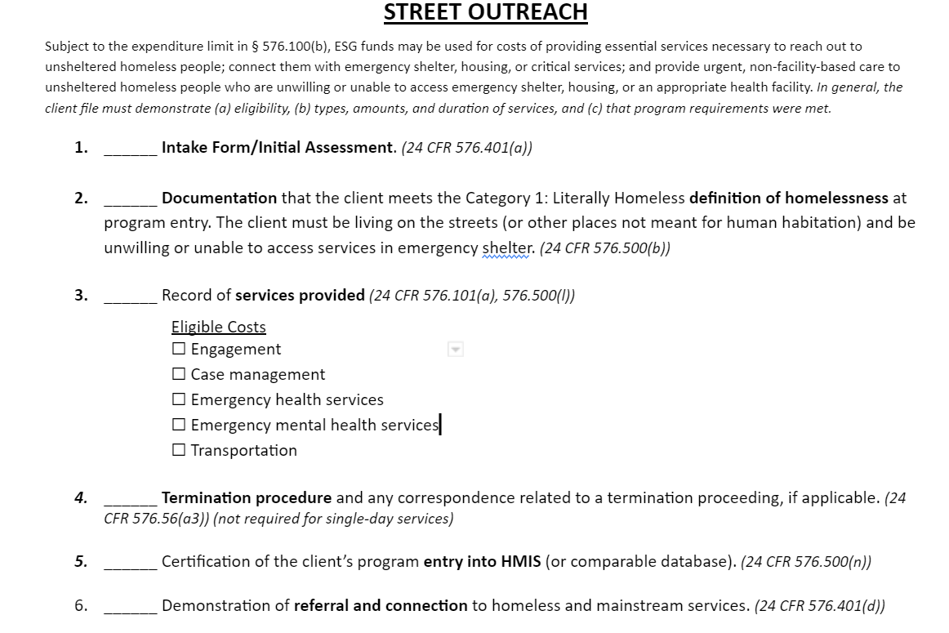
Street Outreach (SO)
Checklist pic
All applicants in an HMIS SO program is included in HUD reporting and assumed eligible and will be subject to monitoring.
SO applicants must be Unsheltered Homeless
Notes:
Faye

Slide 30
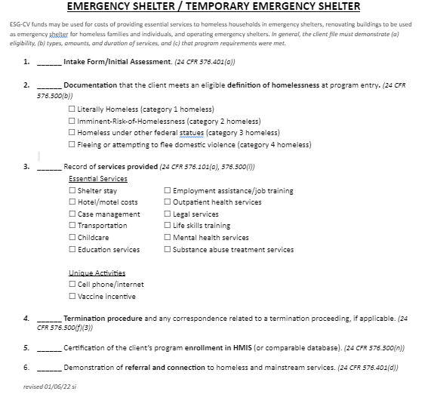
Shelter
All applicants in an HMIS Shelter program is included in HUD reporting and assumed eligible and will be subject to monitoring.
Shelter applicants must meet categories:
Latterly Homeless
or
Fleeing DV
Sign in sheets at a shelter is sufficient to document homeless status.
Homeless certifications are recommended for hotel/motel stays.
HMIS CES is sufficient
Notes:
Faye

Slide 31
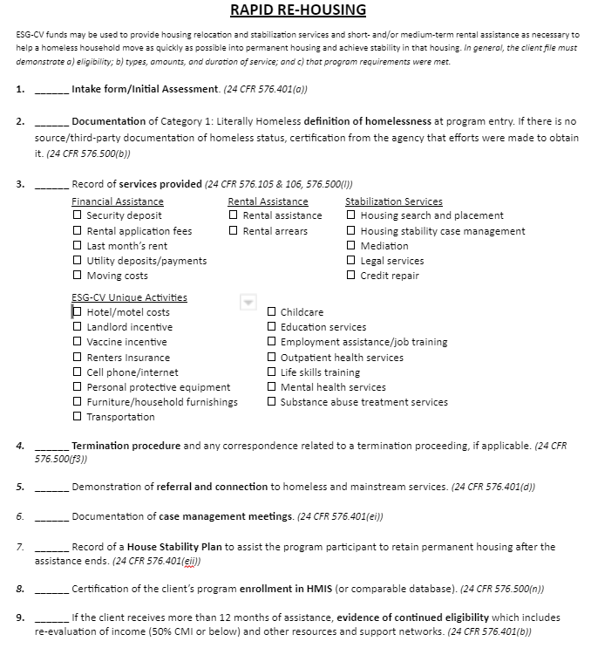
Rapid Rehousing
All applicants in an HMIS RRH program is included in HUD reporting and assumed eligible and will be subject to monitoring.
RRH applicants must meet categories:
Latterly Homeless
or
4) Fleeing DV
Notes:
Faye

Slide 32
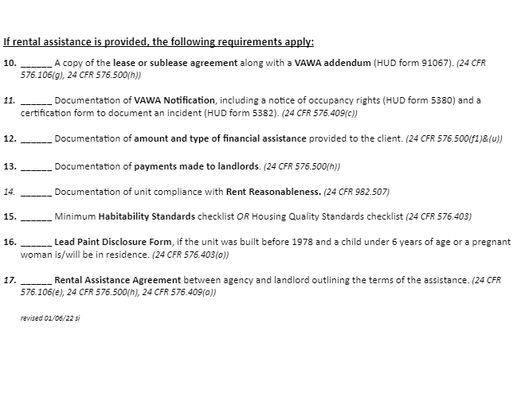
Rapid Rehousing
All applicants in an HMIS RRH program is included in HUD reporting and assumed eligible and will be subject to monitoring.
RRH applicants must meet categories:
Latterly Homeless
or
4) Fleeing DV
Notes:
Faye

Slide 33
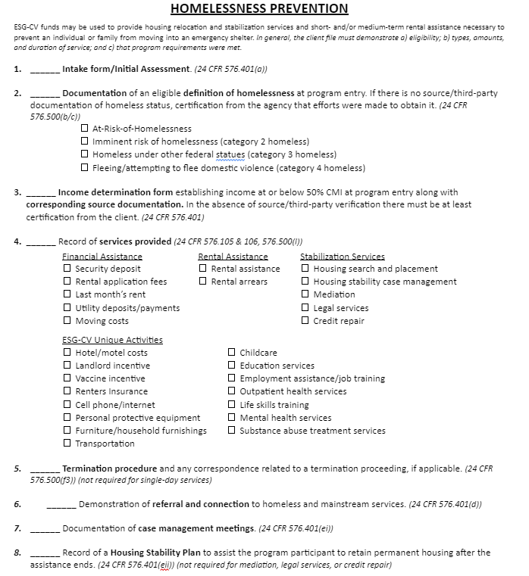
Homeless Prevention
All applicants in an HMIS HP program is included in HUD reporting and assumed eligible and will be subject to monitoring.
Have income at:
30% AMI ESG
HP applicants must verify that they have no resource or support and will be homeless, and meet:
Of the homeless definition
2) Imminent risk
Or
Fleeing DV
Or
One of the conditions identified in category 1 of the At Risk of homelessness definition
Notes:
Faye

Slide 34
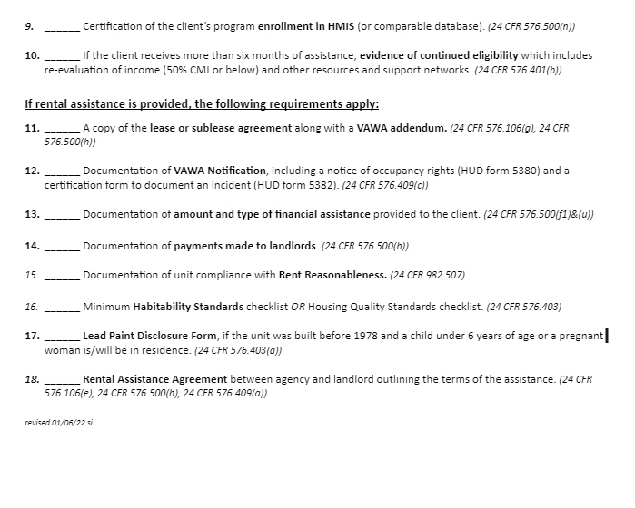
Homeless Prevention
All applicants in an HMIS HP program is included in HUD reporting and assumed eligible and will be subject to monitoring.
Have income at:
30% AMI ESG
HP applicants must verify that they have no resource or support and will be homeless, and meet:
Of the homeless definition
2) Imminent risk
Or
Fleeing DV
Or
One of the conditions identified in category 1 of the At Risk of homelessness definition
Notes:
Faye

Slide 35
HMIS
HMIS funds are used to pay for the use and access for collecting and reporting data in HMIS.
CoCs who are HMIS leads sometimes charges for storing data in the system.
HMIS expenses is described as “to the extent necessary” in the CPD notice
24 CFR 576
Notes:
Faye

Slide 36
Monitoring Tools

Slide 37
Additional monitoring tools
CPD Monitoring Handbook (6509.2) | HUD.gov / U.S. Department of Housing and Urban Development (HUD)

Slide 38
Program Policy and Procedures
All agencies are required to have the following:
Program policy and procedure manual:
Must meet HUD and MHC regulations
Screening, approval/denial, appeals, housing, termination, discharge
Process of reporting concerns
Fair and equal housing
See HUD monitoring tools
Personnel Policy
Needs to include Drug Free Workplace
Process of reporting concerns
Fair and equal employment
See HUD monitoring tools
Fiscal Policy
Needs oversight process
Process of reporting concerns
Budgets
Someone with lived experience must be involved in your policy making, or board, or decisions.
Everything must lineup!!!!!!!

Slide 39
Closeout Process

Slide 40
Closeout Checklist

Slide 41
Certificate of Completion

Slide 42
ESG Report

Slide 43
Agreement to Closeout

Slide 44
Outstanding Claimants

Slide 45
Test Your Knowledge
Should your hard copy files match your electronic files?
Does the client get to choose their desired unit without stipulations? What is it the unit selection based on?
How frequently should a case manger contact an applicant receiving services? How should contact be documented?
What inspection form/method will be required for all units/shelters October 1st?

Slide 47
Contact: Fredrick Davis 601-718-4657 Fredrick.davis@mshc.com

